Slide 1


Sweating the detail: a legal analysis of the Creative Commons licences
Jessica Coates
Project Manager
Creative Commons Clinic
November 2008
CRICOS No. 00213J

Slide 2
Declaration 1:
I work for Creative Commons
CRICOS No. 00213J
Notes:
So why is the NLA using the CC licences?
There is, of course, the obvious ideological reasoning – PictureAustralia is, after all, part of the national collection, and the more freely available the photographs are, the better.
It also provides benefits to the users of PictureAustralia, by creating a pool of photos on the website that can be re-used without needing to get additional permission.
Currently, users have to get permission from the host organisation if they want to reproduce most of the photos in the archive
But most significantly, the NLA also chose to use CC licences because of the benefits content management benefits that provides to them
If anyone has worked in a library, they know that one of the biggest problems with maintaining a collection is making sure that the library has all the permissions it needs to preserve and manipulate the individual works – particularly where the copyright owner may be difficult or impossible to locate
By getting the work under a CC licence, the NLA is able to give people a choice over how their material may be used, whilst still being sure that it has the rights it needs to deal with the work from the outset
This includes making it available on the library’s website, or in a catalogue

Slide 3
Declaration 2:
I’m going to assume you know what I’m talking about
CRICOS No. 00213J
Notes:
So why is the NLA using the CC licences?
There is, of course, the obvious ideological reasoning – PictureAustralia is, after all, part of the national collection, and the more freely available the photographs are, the better.
It also provides benefits to the users of PictureAustralia, by creating a pool of photos on the website that can be re-used without needing to get additional permission.
Currently, users have to get permission from the host organisation if they want to reproduce most of the photos in the archive
But most significantly, the NLA also chose to use CC licences because of the benefits content management benefits that provides to them
If anyone has worked in a library, they know that one of the biggest problems with maintaining a collection is making sure that the library has all the permissions it needs to preserve and manipulate the individual works – particularly where the copyright owner may be difficult or impossible to locate
By getting the work under a CC licence, the NLA is able to give people a choice over how their material may be used, whilst still being sure that it has the rights it needs to deal with the work from the outset
This includes making it available on the library’s website, or in a catalogue

Slide 4
Declaration 3:
This is part of a greater whole
CRICOS No. 00213J
Notes:
So why is the NLA using the CC licences?
There is, of course, the obvious ideological reasoning – PictureAustralia is, after all, part of the national collection, and the more freely available the photographs are, the better.
It also provides benefits to the users of PictureAustralia, by creating a pool of photos on the website that can be re-used without needing to get additional permission.
Currently, users have to get permission from the host organisation if they want to reproduce most of the photos in the archive
But most significantly, the NLA also chose to use CC licences because of the benefits content management benefits that provides to them
If anyone has worked in a library, they know that one of the biggest problems with maintaining a collection is making sure that the library has all the permissions it needs to preserve and manipulate the individual works – particularly where the copyright owner may be difficult or impossible to locate
By getting the work under a CC licence, the NLA is able to give people a choice over how their material may be used, whilst still being sure that it has the rights it needs to deal with the work from the outset
This includes making it available on the library’s website, or in a catalogue

Slide 5
4 common questions
(from lawyers)
What does non-commercial mean?
How do I attribute?
Can I use CC material on an intranet?
Does the licence give me all the rights I need?
CRICOS No. 00213J
Notes:
So why is the NLA using the CC licences?
There is, of course, the obvious ideological reasoning – PictureAustralia is, after all, part of the national collection, and the more freely available the photographs are, the better.
It also provides benefits to the users of PictureAustralia, by creating a pool of photos on the website that can be re-used without needing to get additional permission.
Currently, users have to get permission from the host organisation if they want to reproduce most of the photos in the archive
But most significantly, the NLA also chose to use CC licences because of the benefits content management benefits that provides to them
If anyone has worked in a library, they know that one of the biggest problems with maintaining a collection is making sure that the library has all the permissions it needs to preserve and manipulate the individual works – particularly where the copyright owner may be difficult or impossible to locate
By getting the work under a CC licence, the NLA is able to give people a choice over how their material may be used, whilst still being sure that it has the rights it needs to deal with the work from the outset
This includes making it available on the library’s website, or in a catalogue

Slide 6
What does non-commercial mean?
CRICOS No. 00213J
Notes:
So why is the NLA using the CC licences?
There is, of course, the obvious ideological reasoning – PictureAustralia is, after all, part of the national collection, and the more freely available the photographs are, the better.
It also provides benefits to the users of PictureAustralia, by creating a pool of photos on the website that can be re-used without needing to get additional permission.
Currently, users have to get permission from the host organisation if they want to reproduce most of the photos in the archive
But most significantly, the NLA also chose to use CC licences because of the benefits content management benefits that provides to them
If anyone has worked in a library, they know that one of the biggest problems with maintaining a collection is making sure that the library has all the permissions it needs to preserve and manipulate the individual works – particularly where the copyright owner may be difficult or impossible to locate
By getting the work under a CC licence, the NLA is able to give people a choice over how their material may be used, whilst still being sure that it has the rights it needs to deal with the work from the outset
This includes making it available on the library’s website, or in a catalogue

Slide 7
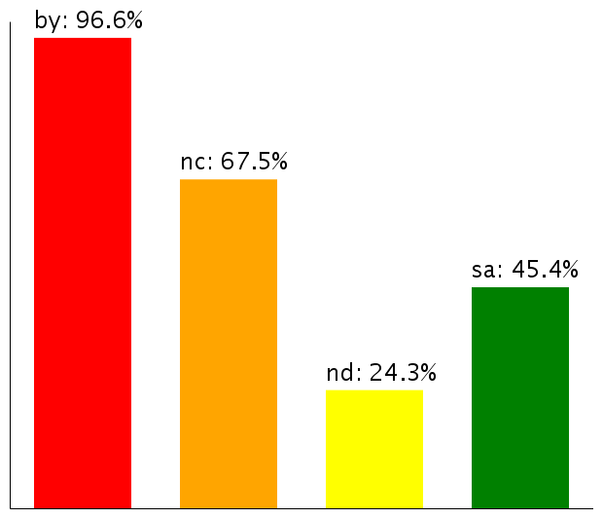
http://wiki.creativecommons.org/License_statistics
CRICOS No. 00213J
Notes:
NC is the most popular of CC’s licence elements

Slide 8
“confusing” - American Society of Composers, Authors
and Publishers, 2007
“vague” – Eric Moller (Freedom Defined) 2007
“dangerously ill-defined” - Gordon Haff
(CNet Blogs) 2008
CRICOS No. 00213J
Notes:
However, it is also the most criticised
It’s criticised by the copyright establishment, open culture advocates and community members
While some in the open source community question whether NC is really “open”
The main criticism is that it’s not well enough defined

Slide 9



Facebook ToU
Xbox ‘Game Content Usage Rules
PM’s website
CRICOS No. 00213J
Notes:
In fact, it’s not just CC using it – it’s now being used by lots of different licences
So there is clearly a demand for it

Slide 10
“non-profit”
“reasonable”
“public”
“commercially available”
“undue”
“commercial gain”
“private and domestic”
CRICOS No. 00213J
Notes:
But the copyright world is full of ‘vague’ and ‘undefined’ terms
These are some from the copyright act alone – let alone terms used in all the different licences out there
So why are people so uncomfortable with NC?
Looking beyond any uncharitable suggestion that it’s just because it’s associated with CC
The most likely answer seems to be that it’s because the term is new
While all these other terms have been discussed back on forth for years, used in contracts and court cases
NC is yet to be defined in this way
Unfortunately, there haven’t really been any court cases, that I’ve found anyway, that include the term

Slide 11
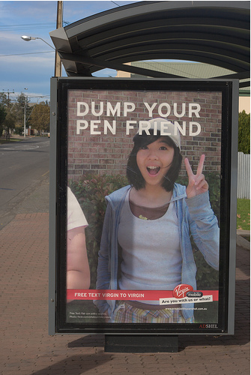


Dump your pen friend by sesh00
http://www.flickr.com/photos/sesh00/
515961023/in/pool-379879@N24
‘CIMG0903.JPG’ by Adam Curry http://www.flickr.com/photos/adamc1999/75153930/
Curry v. Audax
Virgin Mobile (pending)
Sociedad General de Autores y
Editores (SGAE) v Fernandez
CRICOS No. 00213J
Notes:
The only CC cases we’ve had so far have all involved clearly commercial uses
A tabloid magazine using an NC-licensed photo, a bar using CC-licensed music and Virgin Mobile using BY licensed photographs

Slide 12
Music on Hold Case
Telstra Corporation Ltd v Australasian Performing Right Association Ltd (1997)
to the public = the copyright owner’s public
Dawson & Gaudron JJ: “Lying behind the concept of the copyright owner's public is recognition of the fact that where a work is performed in a commercial setting, the occasion is unlikely to be private or domestic.”
CRICOS No. 00213J
Notes:
The closest thing to a case law definition of commercial I’ve found so far in Australia is Telstra v APRA
and it’s really talking about commerciality as an aspect of a public use, not what commercial means

Slide 13
No Precedent
Traditionally, public = commercial
So copyright relied on public v private - “performance in public”, “communication to the public”, “publication”
Now private actions have “commercial impact”. People “share” with 1 million of their closest friends.
CRICOS No. 00213J

Slide 14
“You may not exercise any of the rights granted to You . . . in any manner that is primarily intended for or directed toward commercial advantage or private monetary compensation. The exchange of the Work for other copyrighted works by means of digital file-sharing or otherwise shall not be considered to be intended for or directed toward commercial advantage or private monetary compensation, provided there is no payment of any monetary compensation in connection with the exchange of copyrighted works.”
CRICOS No. 00213J
Notes:
So why is the NLA using the CC licences?
There is, of course, the obvious ideological reasoning – PictureAustralia is, after all, part of the national collection, and the more freely available the photographs are, the better.
It also provides benefits to the users of PictureAustralia, by creating a pool of photos on the website that can be re-used without needing to get additional permission.
Currently, users have to get permission from the host organisation if they want to reproduce most of the photos in the archive
But most significantly, the NLA also chose to use CC licences because of the benefits content management benefits that provides to them
If anyone has worked in a library, they know that one of the biggest problems with maintaining a collection is making sure that the library has all the permissions it needs to preserve and manipulate the individual works – particularly where the copyright owner may be difficult or impossible to locate
By getting the work under a CC licence, the NLA is able to give people a choice over how their material may be used, whilst still being sure that it has the rights it needs to deal with the work from the outset
This includes making it available on the library’s website, or in a catalogue

Slide 15
The contenders
Copyright Act/AUSFTA
“commercial/financial advantage or profit”
Netherlands trial
anything BUMA doesn’t collect for
CC guidelines/KODA trial
judge by type of user and use – thorough but complication
CRICOS No. 00213J
Notes:
So why is the NLA using the CC licences?
There is, of course, the obvious ideological reasoning – PictureAustralia is, after all, part of the national collection, and the more freely available the photographs are, the better.
It also provides benefits to the users of PictureAustralia, by creating a pool of photos on the website that can be re-used without needing to get additional permission.
Currently, users have to get permission from the host organisation if they want to reproduce most of the photos in the archive
But most significantly, the NLA also chose to use CC licences because of the benefits content management benefits that provides to them
If anyone has worked in a library, they know that one of the biggest problems with maintaining a collection is making sure that the library has all the permissions it needs to preserve and manipulate the individual works – particularly where the copyright owner may be difficult or impossible to locate
By getting the work under a CC licence, the NLA is able to give people a choice over how their material may be used, whilst still being sure that it has the rights it needs to deal with the work from the outset
This includes making it available on the library’s website, or in a catalogue

Slide 16
What is CC doing?
independent international survey (quantitative and qualitative data)
will inform future educational material and licence development
be wary of over defining
CRICOS No. 00213J
Notes:
So why is the NLA using the CC licences?
There is, of course, the obvious ideological reasoning – PictureAustralia is, after all, part of the national collection, and the more freely available the photographs are, the better.
It also provides benefits to the users of PictureAustralia, by creating a pool of photos on the website that can be re-used without needing to get additional permission.
Currently, users have to get permission from the host organisation if they want to reproduce most of the photos in the archive
But most significantly, the NLA also chose to use CC licences because of the benefits content management benefits that provides to them
If anyone has worked in a library, they know that one of the biggest problems with maintaining a collection is making sure that the library has all the permissions it needs to preserve and manipulate the individual works – particularly where the copyright owner may be difficult or impossible to locate
By getting the work under a CC licence, the NLA is able to give people a choice over how their material may be used, whilst still being sure that it has the rights it needs to deal with the work from the outset
This includes making it available on the library’s website, or in a catalogue

Slide 17
How do I attribute?
CRICOS No. 00213J
Notes:
So why is the NLA using the CC licences?
There is, of course, the obvious ideological reasoning – PictureAustralia is, after all, part of the national collection, and the more freely available the photographs are, the better.
It also provides benefits to the users of PictureAustralia, by creating a pool of photos on the website that can be re-used without needing to get additional permission.
Currently, users have to get permission from the host organisation if they want to reproduce most of the photos in the archive
But most significantly, the NLA also chose to use CC licences because of the benefits content management benefits that provides to them
If anyone has worked in a library, they know that one of the biggest problems with maintaining a collection is making sure that the library has all the permissions it needs to preserve and manipulate the individual works – particularly where the copyright owner may be difficult or impossible to locate
By getting the work under a CC licence, the NLA is able to give people a choice over how their material may be used, whilst still being sure that it has the rights it needs to deal with the work from the outset
This includes making it available on the library’s website, or in a catalogue

Slide 18
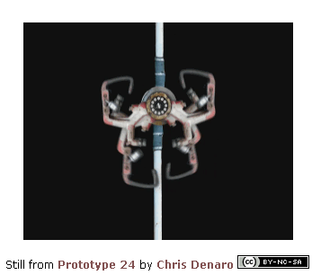
cl.4(b) – Must provide, reasonable to the medium:
  name of author and/or designated ‘Attribution Parties’;
  title of work;
  any specified Uniform Resource Identifier (ie link) – where practical.
cl.4(a) - Must reference CC licence
CRICOS No. 00213J
Notes:
Shouldn’t be a problem - spelt out fairly clearly in the licences

Slide 19
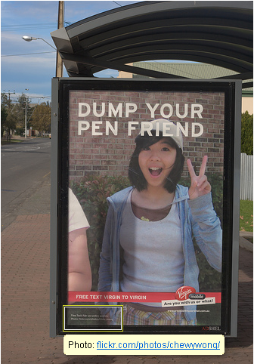
right intent, but not licence compliant
probably needs to be more explicit even to be ‘reasonable’ – and what about the licence?
at very least, should have linked to photo page, not just profile
Dump your pen friend by sesh00
http://www.flickr.com/photos/sesh00/515961023/in/pool-379879@N24
CRICOS No. 00213J
Notes:
People still have problems – eg Virgin, Children of Men,

Slide 20
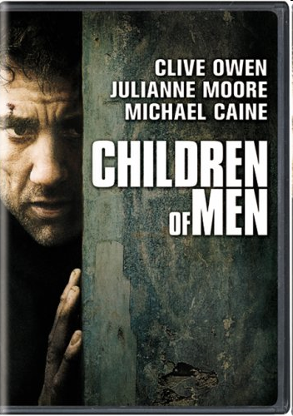

Much better, but still no mention of the CC licence
CRICOS No. 00213J
Notes:
People still have problems – eg Virgin, Children of Men,

Slide 21
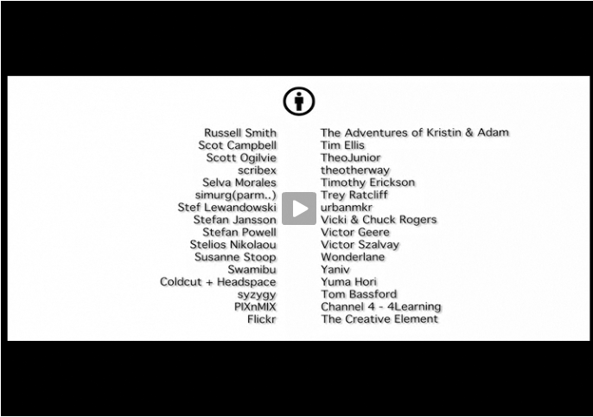
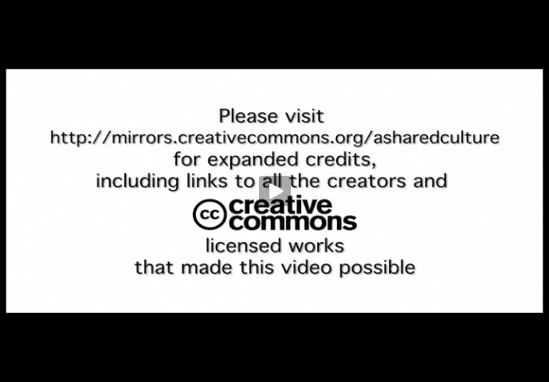
Even CC endorsed projects can be questionable
A Shared Culture by Jesse Dylan, http://creativecommons.org/asharedculture
CRICOS No. 00213J
Notes:
Even CC video

Slide 22
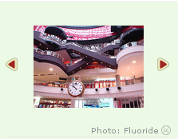
Links to photopage on Flickr
Links to CC licence
http://www.schmap.com/
CRICOS No. 00213J
Notes:
Though some clever, accurate applications exist

Slide 23
Can I use CC material on an intranet?
CRICOS No. 00213J
Notes:
So why is the NLA using the CC licences?
There is, of course, the obvious ideological reasoning – PictureAustralia is, after all, part of the national collection, and the more freely available the photographs are, the better.
It also provides benefits to the users of PictureAustralia, by creating a pool of photos on the website that can be re-used without needing to get additional permission.
Currently, users have to get permission from the host organisation if they want to reproduce most of the photos in the archive
But most significantly, the NLA also chose to use CC licences because of the benefits content management benefits that provides to them
If anyone has worked in a library, they know that one of the biggest problems with maintaining a collection is making sure that the library has all the permissions it needs to preserve and manipulate the individual works – particularly where the copyright owner may be difficult or impossible to locate
By getting the work under a CC licence, the NLA is able to give people a choice over how their material may be used, whilst still being sure that it has the rights it needs to deal with the work from the outset
This includes making it available on the library’s website, or in a catalogue

Slide 24
The question
CC licences ban the use of TPMs on CC material
Some people query whether CC material can be used on password protected systems (eg intranets)
CRICOS No. 00213J
Notes:
Shouldn’t be a problem - spelt out fairly clearly in the licences

Slide 25
“When You Distribute or Publicly Perform the Work, You may not impose any effective technological measures on the Work that restrict the ability of a recipient of the Work from You to exercise the rights granted to that recipient under the terms of the License. ”
CRICOS No. 00213J
Notes:
Shouldn’t be a problem - spelt out fairly clearly in the licences

Slide 26
“Subject to the terms and conditions of this License, Licensor hereby grants You a worldwide, royalty-free, non-exclusive, perpetual (for the duration of the applicable copyright) license to exercise the rights in the Work as stated below:
to Reproduce the Work, to incorporate the Work into one or more Collections, and to Reproduce the Work as incorporated in the Collections;
to create and Reproduce Adaptations provided that any such Adaptation, including any translation in any medium, takes reasonable steps to clearly label, demarcate or otherwise identify that changes were made to the original Work. For example, a translation could be marked "The original work was translated from English to Spanish," or a modification could indicate "The original work has been modified.";
to Distribute and Publicly Perform the Work including as incorporated in Collections; and,
to Distribute and Publicly Perform Adaptations.”
CRICOS No. 00213J
Notes:
Shouldn’t be a problem - spelt out fairly clearly in the licences

Slide 27
Conclusion
As long as the system lets you reproduce and distribute, it is CC compatible
CRICOS No. 00213J
Notes:
Shouldn’t be a problem - spelt out fairly clearly in the licences

Slide 28
Does the CC licence give me all the rights I need?
CRICOS No. 00213J
Notes:
So why is the NLA using the CC licences?
There is, of course, the obvious ideological reasoning – PictureAustralia is, after all, part of the national collection, and the more freely available the photographs are, the better.
It also provides benefits to the users of PictureAustralia, by creating a pool of photos on the website that can be re-used without needing to get additional permission.
Currently, users have to get permission from the host organisation if they want to reproduce most of the photos in the archive
But most significantly, the NLA also chose to use CC licences because of the benefits content management benefits that provides to them
If anyone has worked in a library, they know that one of the biggest problems with maintaining a collection is making sure that the library has all the permissions it needs to preserve and manipulate the individual works – particularly where the copyright owner may be difficult or impossible to locate
By getting the work under a CC licence, the NLA is able to give people a choice over how their material may be used, whilst still being sure that it has the rights it needs to deal with the work from the outset
This includes making it available on the library’s website, or in a catalogue

Slide 29
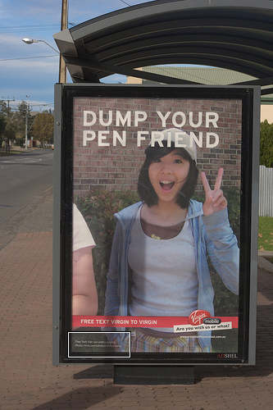
The question
Did Virgin need the model’s permission to use her image in their advertisement?
ie CC licences only deal with copyright - should they be providing clearance for other rights? eg model rights
CRICOS No. 00213J
Notes:
People still have problems – eg Virgin, Children of Men,

Slide 30
Model Clearances
Trade Practices Act Section 53
prohibits commercial conduct that: “falsely represent[s] that a particular person has agreed to acquire goods or services [or] . . . represent[s] that goods or services have sponsorship, approval, performance characteristics, accessories, uses or benefits they do not have.”
Does this apply in the absence of celebrity/public reputation?
(Talmax v Telstra; Pacific Dunlop v Hogan; Honey v
Australian Airlines)
Do the Virgin Mobile ads imply sponsorship or approval?
CRICOS No. 00213J
Notes:
People still have problems – eg Virgin, Children of Men,

Slide 31
Extra Rights
Who should be clearing ‘additional’ rights – the creator or the user?
Many laws in many countries; most apply only to certain uses
Only user can know for certain what their use is, and therefore which rights will be required
CRICOS No. 00213J
Notes:
People still have problems – eg Virgin, Children of Men,

Slide 32
What’s CC doing?
already has FAQ
best practice guidelines on using photos
separate model clearance project
change licence deed?
CRICOS No. 00213J
Notes:
What’s CC doing? Already has FAQ, also marking project, debate in community on whether licence should be relaxed.

Slide 33
Can APRA members use CC licences?
Not without APRA’s permission
Will the licences hold up in court?
Looks like it
How do you enforce the licences?
Same as any other licence
How can derivative works be licensed?
It’s complicated
Can I put CC-licensed material on Youtube?
Yes if it’s yours, no if it’s someone else’s
CRICOS No. 00213J
Notes:
So why is the NLA using the CC licences?
There is, of course, the obvious ideological reasoning – PictureAustralia is, after all, part of the national collection, and the more freely available the photographs are, the better.
It also provides benefits to the users of PictureAustralia, by creating a pool of photos on the website that can be re-used without needing to get additional permission.
Currently, users have to get permission from the host organisation if they want to reproduce most of the photos in the archive
But most significantly, the NLA also chose to use CC licences because of the benefits content management benefits that provides to them
If anyone has worked in a library, they know that one of the biggest problems with maintaining a collection is making sure that the library has all the permissions it needs to preserve and manipulate the individual works – particularly where the copyright owner may be difficult or impossible to locate
By getting the work under a CC licence, the NLA is able to give people a choice over how their material may be used, whilst still being sure that it has the rights it needs to deal with the work from the outset
This includes making it available on the library’s website, or in a catalogue

Slide 34

Thanks
http://www.creativecommons.org
http://www.creativecommons.org.au
info@creativecommons.org.au
This slide show is licensed under a Creative Commons Australia Attribution licence. For more information see http://creativecommons.org/licenses/by/2.5/au/.
AUSTRALIA
part of the Creative Commons international initiative
CRICOS No. 00213J

